Slide 1

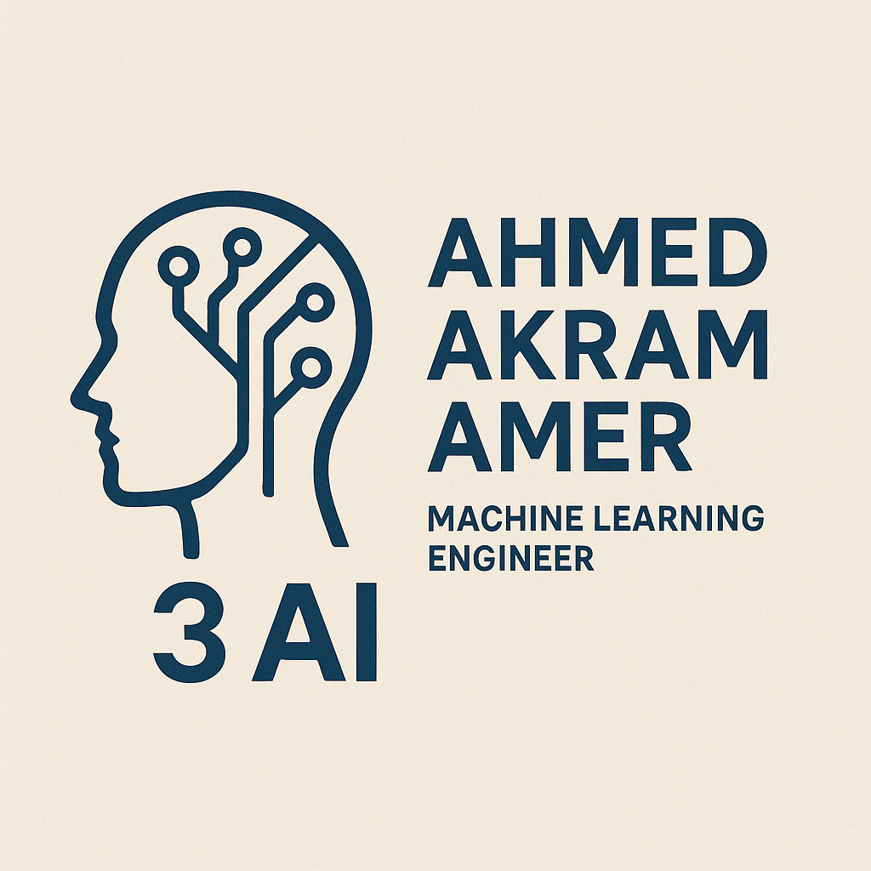
Unsupervised ML
Ahmed Akram Amer

Slide 2
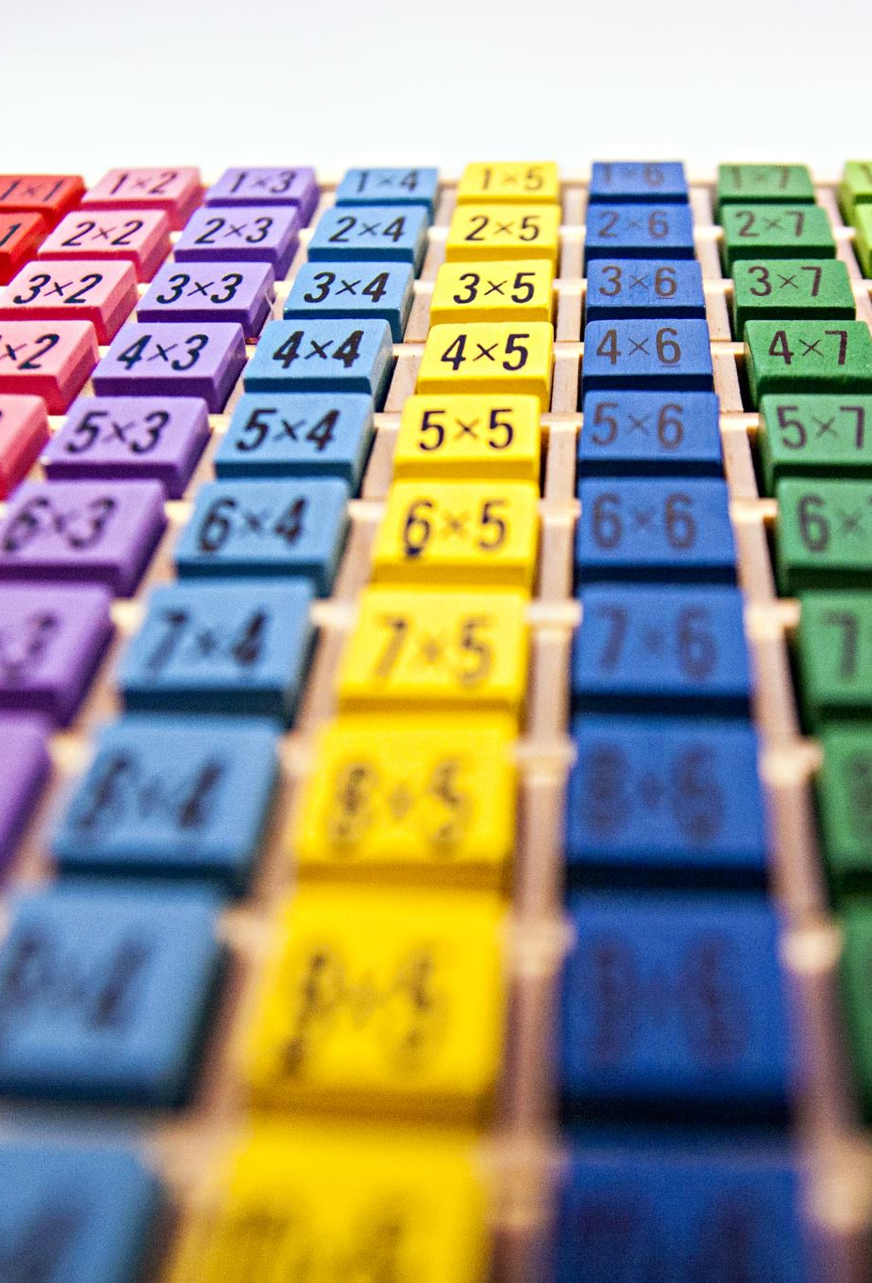
Agenda
What is Unsupervised ML?
Difference between Supervised and Unsupervised.
Main Tasks
Clustering (main focus)
Key Terminologies
K-Means Algorithm
Python Implementation
Summary & Q&A

Slide 3
What Is Unsupervised ML ..?
Unsupervised ML : branch of Machine Learning that deals with unlabeled data
Unsupervised ML Algorithms are tasked to find patterns and relationships within data without any prior knowledge.
The Training Model has only the input parameters values and discover the groups or hidden patterns on its own

Slide 4
The Difference
Supervised ML | Unsupervised ML
Uses Labeled Data (Inputs + Corresponding Output) | Uses Unlabeled Data ( Inputs and No Outputs)
Predicts outcomes or classifies data based on known labels. | Discovers hidden patterns, structures, or groupings in data.
Less complex, as the model learns from labeled data with clear guidance. | More complex, as the model must find patterns without any guidance.
Two types : Classification (for discrete outputs) or regression (for continuous outputs). | Clustering and association
Model can be tested and evaluated using labeled test data. | Cannot be tested in the traditional sense, as there are no labels.

Slide 5
Main tasks
1- Clustering
Groups similar data points together based on features.
Common algorithms: K-means, hierarchical clustering, DBSCAN.
2- Association
Discovers interesting relationships between variables in large datasets.
Commonly used in market basket analysis to find product associations
3- Dimensionality Reduction
Reduces the number of features while preserving essential information.
Techniques include Principal Component Analysis (PCA) and t-Distributed Stochastic Neighbor Embedding (t-SNE).

Slide 6
Continue..
4- Anomaly Detection
Identifies outliers or unusual data points that differ significantly from the majority.
Useful in fraud detection, network security, and fault detection.
5- Feature Learning
Automatically extracts relevant features from raw data.
Often used in deep learning models to improve performance on tasks like image and speech recognition.

Slide 7
Clustering
Clustering is a data analysis technique used to group similar items or data points based on specific characteristics. It is commonly applied in various fields such as machine learning, statistics, and data mining.
Involves partitioning a dataset into subsets (clusters) where items in the same cluster are more similar to each other than to those in other clusters.
It helps in identifying patterns, simplifying data analysis, and making predictions.
Common Algorithms:
K-Means: Divides data into K clusters by minimizing variance within each cluster.
Hierarchical Clustering: Builds a tree of clusters based on distance metrics.
DBSCAN: Groups points that are closely packed together while marking outliers as noise.

Slide 8
Continue..
Applications:
Market Segmentation: Identifying distinct customer groups for targeted marketing.
Image Segmentation: Grouping pixels in images for analysis.
Anomaly Detection: Identifying unusual data points that do not fit into any cluster.
Evaluation Metrics:
Silhouette Score: Measures how similar an object is to its own cluster compared to other clusters.
Dunn Index: Evaluates the compactness and separation of clusters.
Clustering is a powerful tool for exploratory data analysis and can provide insights that guide decision-making across various domains.

Slide 9
Key Terms in Clustering
Cluster: A collection of data points that are more similar to each other than to those in other clusters.
Centroid: The center point of a cluster, often calculated as the mean of all points in the cluster.
Distance Metric: A method for measuring the distance between data points, commonly using Euclidean or Manhattan distance.
Inertia: A measure of how tightly the clusters are packed, calculated as the sum of squared distances between points and their respective centroids.
Silhouette Score: A metric that evaluates how similar an object is to its own cluster compared to other clusters, ranging from -1 to 1.

Slide 10
Continue..
Hierarchical Clustering: A method that builds a hierarchy of clusters either through agglomerative (bottom-up) or divisive (top-down) approaches.
K-Means: A popular clustering algorithm that partitions data into K clusters by minimizing inertia.
DBSCAN (Density-Based Spatial Clustering of Applications with Noise): A clustering algorithm that groups together points that are closely packed and marks as outliers points that lie alone in low-density regions.
Overfitting: A situation where a clustering model captures noise in the data rather than the underlying pattern, leading to poor generalization.
Dimensionality Reduction: Techniques like PCA (Principal Component Analysis) used to reduce the number of features in the data while preserving its structure, often applied before clustering.

Slide 11

Q & A Linkedin

